Slide 1
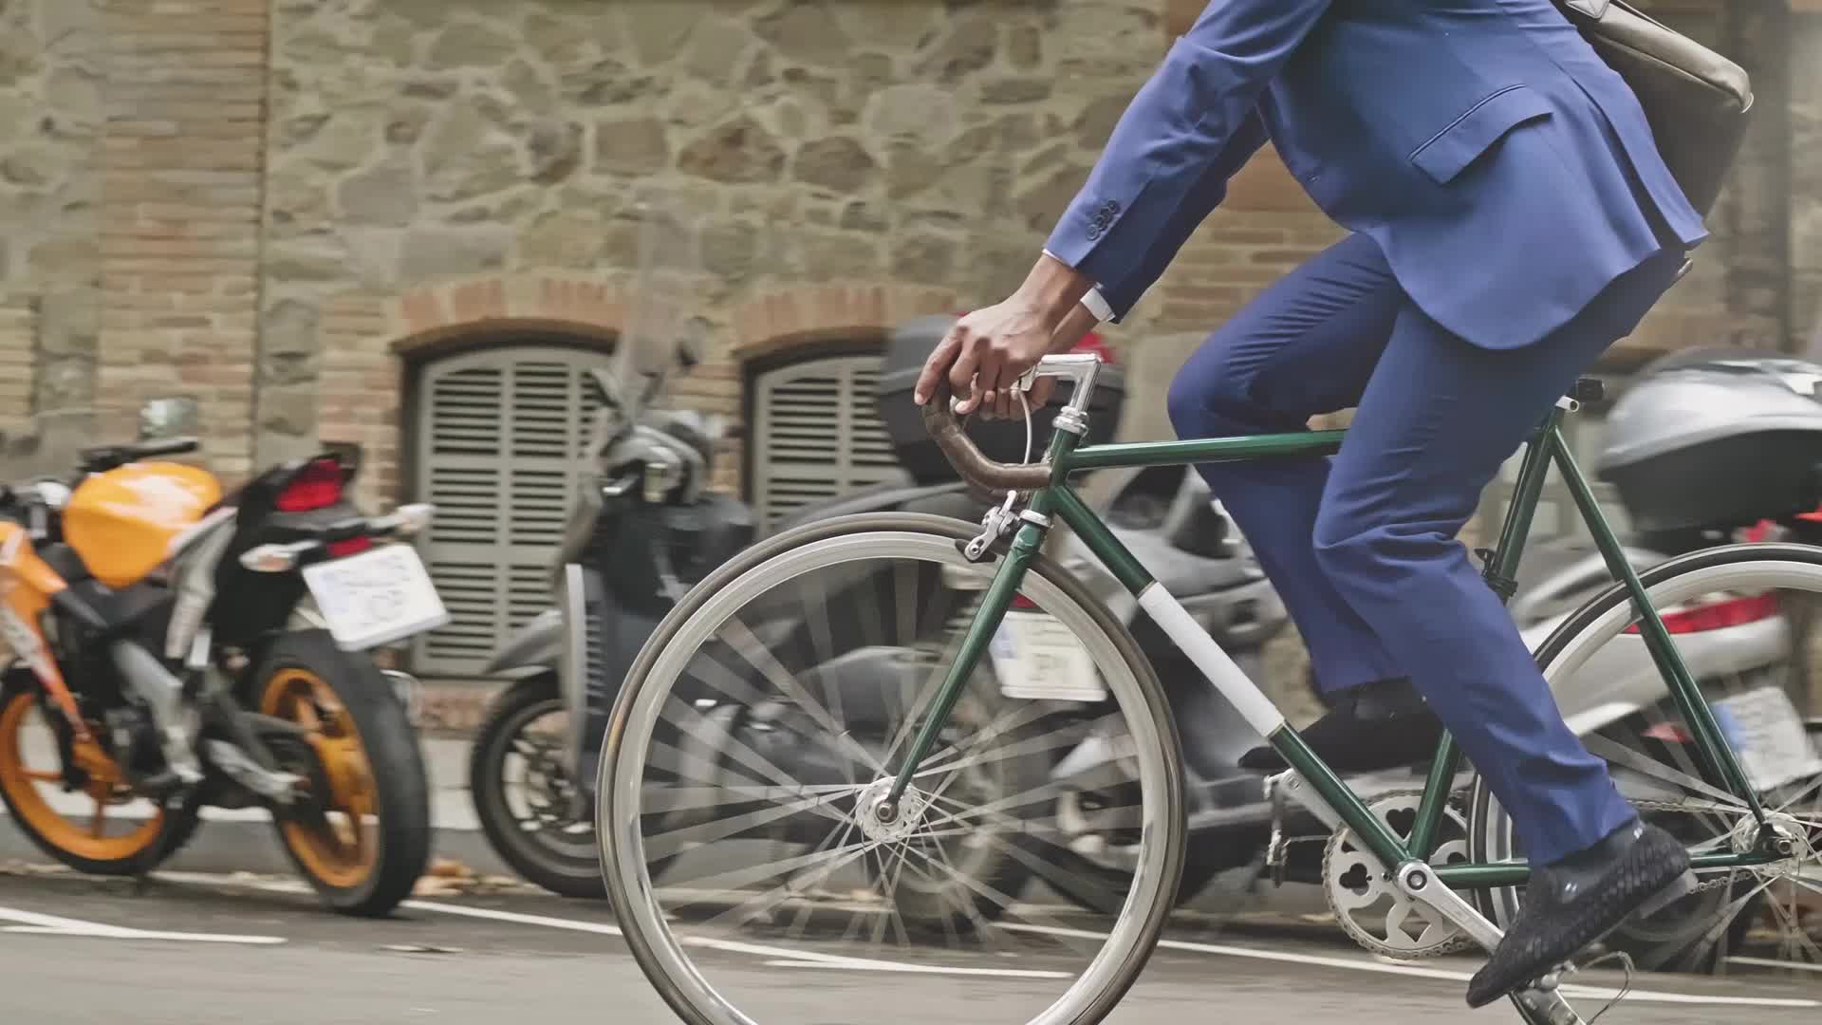
Case Study: CYCLISTIC BIKE SHARE * This case study serves as the capstone of the Google Data Analytics Professional Certificate
July 7, 2023
By: Syed Muhammad Iqbal

Slide 2
Contents:
Introduction
Data Insights
Summary
Recommendations
Appendix

Slide 3


Introduction

Slide 4
Scenario
Cyclistic: A bike-share program that features more than 5,800 bicycles and 600 docking stations. Cyclistic sets itself apart by also offering reclining bikes, hand tricycles, and cargo bikes, making bike-share more inclusive to people with disabilities and riders who can’t use a standard two-wheeled bike. The majority of riders opt for traditional bikes; about 8% of riders use the assistive options. Cyclistic users are more likely to ride for leisure, but about 30% use them to commute to work each day.
The marketing director of Cyclistic, a bike-share company in Chicago, believes the company’s future success depends on maximizing the number of annual memberships. Therefore, this analysis is to understand how casual riders and annual members use Cyclistic bikes differently. From these insights, we will design a new marketing strategy to convert casual riders into annual members.

Slide 5
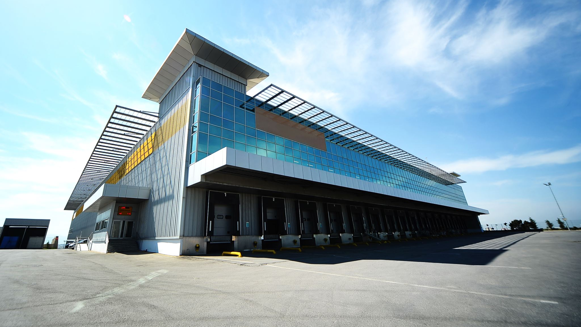
About the Company
In 2016, Cyclistic launched a successful bike-share offering. Since then, the program has grown to a fleet of 5,824 bicycles that are geotracked and locked into a network of 692 stations across Chicago. The bikes can be unlocked from one station and returned to any other station in the system anytime.
Cyclistic pricing plans:
single-ride passes (*)
full-day passes (*)
annual memberships. (**)
* Casual riders.
** Cyclistic members.

Slide 6
Problem statements:
The differences between casual riders and annual members using the Cyclistic bikes
2) How to influence casual riders to become annual members
Business Task:
To identify how do annual members and casual riders use Cyclistic bikes differently. The analysis will later be used by marketing team to develop a marketing strategy to convert casual riders into annual members
Primary Stakeholders:
Lily Moreno: The director of marketing. Moreno is responsible for the development of campaigns and initiatives to promote the bike-share program. These may include email, social media, and other channels.
Cyclistic executive team: The notoriously detail-oriented executive team will decide whether to approve the recommended marketing program.

Slide 7
Data insight

Slide 8
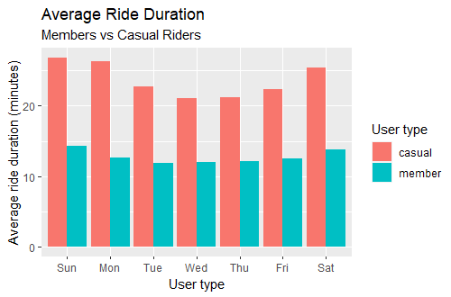
1) Daily Average Ride Duration
Casual riders spent almost double time duration compared to Membership riders
Both users slightly spend more time to ride on weekends compare to weekdays

Slide 9
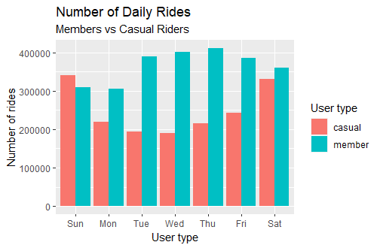
2) Total Count of Daily Rides
Members appear to have higher ridership on weekdays.
Conversely, casual riders appear to have a higher average ridership on weekends

Slide 10
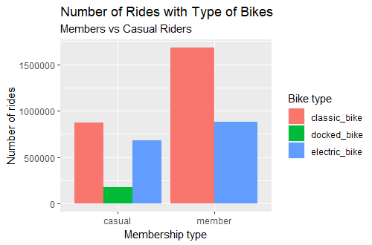
3) Number of Rides for Both Users vs Type of Bikes
Both users likely to prefer classic bikes than electric bikes.
Almost more than half of members choosing classic bikes than electric bikes.
Members of cyclistic membership does not use any docked bike.

Slide 11
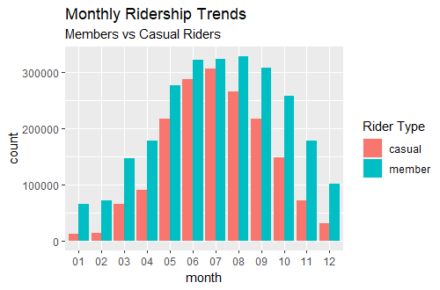
4) Monthly Number of Rides for Both Users
Both users use the most of cyclistic bikes on mid year, and tend to decrease towards end of the year and early year

Slide 12
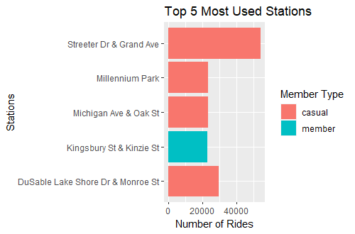
5) Top 5 Most Used Start Stations
From the most 5 used stations, 4 of them mostly used by casual riders

Slide 13
summary

Slide 14
Summary
Overall, casual riders take less numbers of rides,
but for longer durations
Casual riders mostly use bikes on weekends,
supposedly for recreational purposes
Casual riders mostly use classic bikes, followed by
electric bikes. But also use docked bike which are not use by our currently Members
Most of the casual riders focusing on the same stations, as shown in 4 out of 5 most use stations
Casual users use the most rides on Mid Year,
And starting to decrease at the end and early year

Slide 15
recommendations

Slide 16
Here are my top 5 recommendations based on above key findings:
Insight 1) If riders are charged on duration basis, offer special membership discount coupons for more longer rides duration as casual riders spent more time on the bikes. This can encourage them to sign for membership
Insight 2) Design a package for recreational activities on the weekend, targeting for the casual riders
Insight 3) Classic bikes is popular than electric bikes for both users. But only casual riders are using docked bike. Focusing suitable campaigns on docked bike might convert some casual riders to members
Insight 4) Mid year especially May to Oct shows significance number of rides for casual riders. Channeling correct advertisement during this timeline can attract more casual riders to become members
Insight 5) 4 of the most used as start stations are use by casual riders. Increase proper advertisement at this stations to attract more casual riders join as members

Slide 17
appendix

Slide 18
This dataset consist of 12 dataset from each month in 2022:
Link - analyzed period 01/22’ ~ 12/22’ (Note: The datasets have a different name because Cyclistic is a fictional company.
The data has been made available by Motivate International Inc. under this license.)
The dataset consists of 12 CSV files (each for a month) with 13 columns and more than 4 million rows.
Complete Analysis are in the GitHub Link below:
https://github.com/iqbal159/Project3_Data-Analytic-with-R

Slide 19
Thank you!

